Slide 1
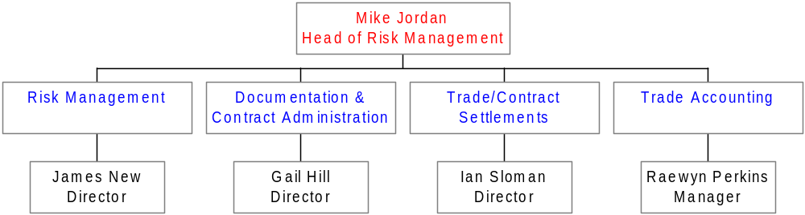
European Trading Support

Slide 2
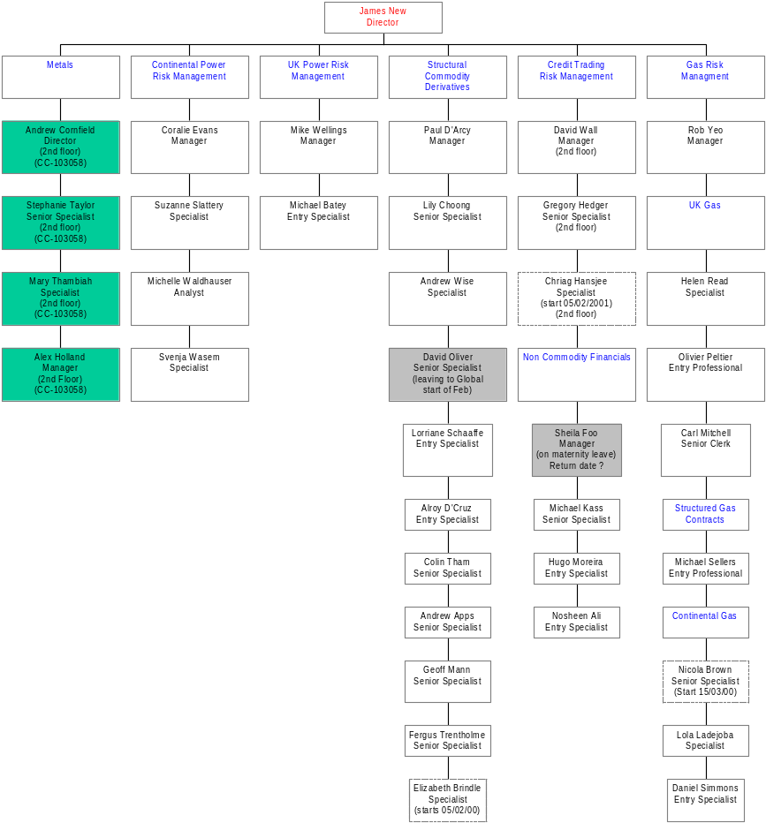
European Risk Management
Headcount – January 2001
4 - Head of Risk 4
28 – perm
3 – to arrive
1- to leave (internal)
1 – maternity leave
Actual – 29
(4- Metals – cc – 103058) = 33
Budget -32

Slide 3
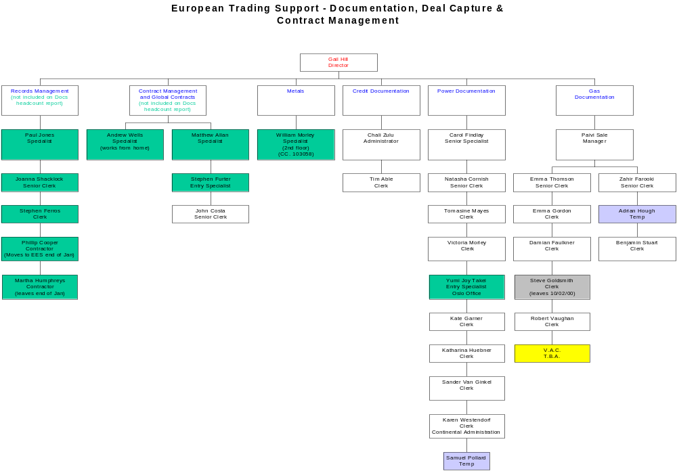
Headcount – January 2001
18 - perm
2 – temp
1 – vacancy
1 - leave
Actual – 21 = ( 7 below budget)
(Records Management – 5
Contract Management –4
Oslo – 1
Metals - 1
Not included in Docs headcount budget)
(Total = 32)
Budget 28

Slide 4
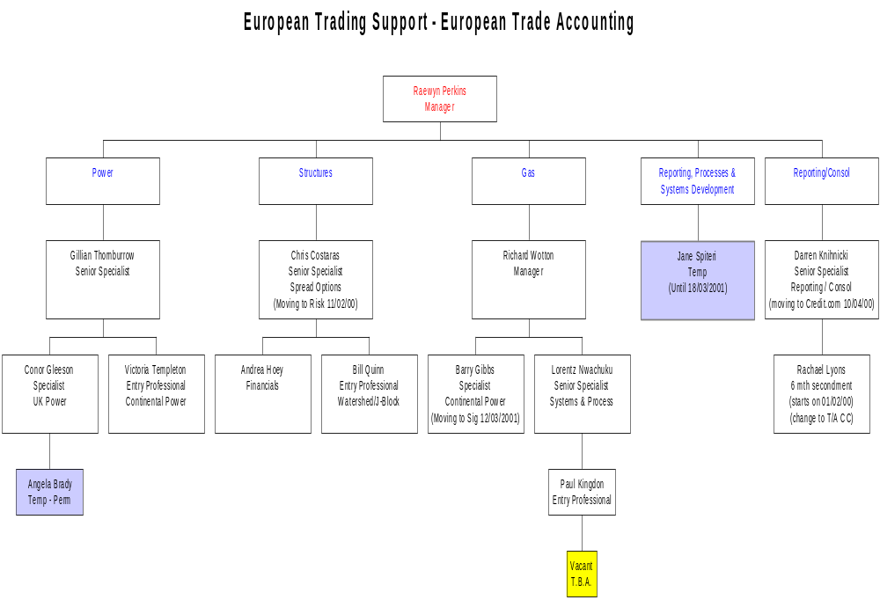
Headcount – January 2001
12– perm
2 – temp
1 - Vacant
Actual - 14
Budget - 15

Slide 5
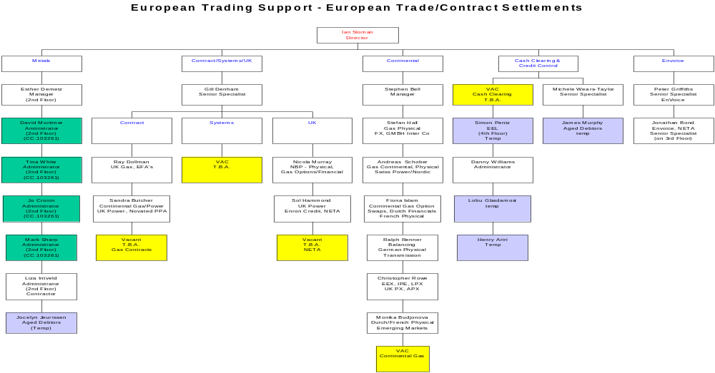
Headcount – January 2001
18 - perm
4 - temp
5 - vacancy
Actual – 22 (22 + 6 – Metals)
Budget - 27

